Slide 1
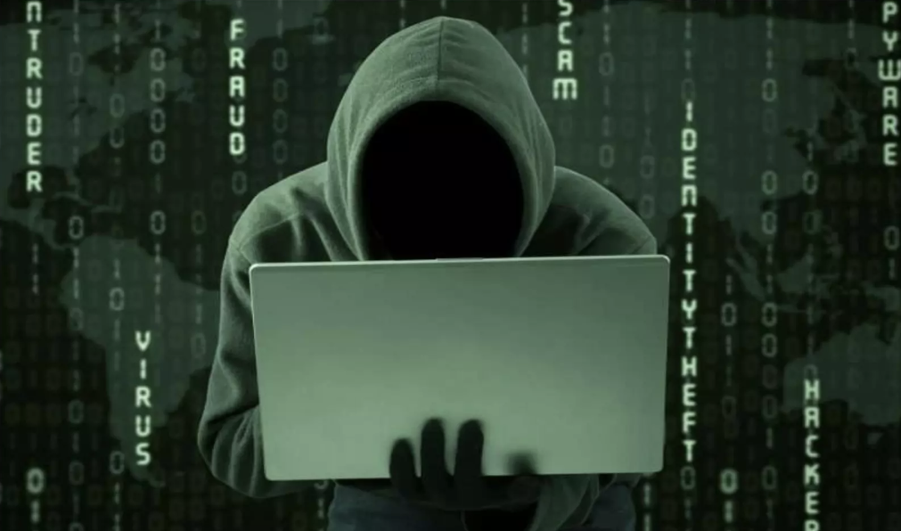
Lock Icon

Slide 2
Lock Icon In Browser
Symmetric Key Challenge-Response handshake.
Identity: Alice says, "Hi, I'm Alice."
Challenge (Nonce): Bob sends a random string of numbers. This is the Nonce (meaning "Number used ONCE"). It ensures this specific conversation can never be repeated by a hacker later.
Response: Alice encrypts that Nonce using their shared secret key and sends it back.
Verification: Bob decrypts it. If the number inside matches the Nonce he just sent, he knows it’s really Alice.

Slide 3
Lock Icon In Browser
The lock icon is directly related to a digital certificate (specifically an SSL/TLS certificate).
Lock means your browser has successfully performed a "handshake" with the website’s server using its digital certificate to establish a secure, encrypted connection.

Slide 4
Lock Icon In Browser
How the Lock and Certificate Work Together
Authentication: The certificate acts like a "digital passport." The lock icon appears only after our browser confirms the certificate was issued by a trusted authority and actually belongs to the website you are visiting.
Encryption: Once the certificate is verified, the browser uses the Public Key inside that certificate to encrypt data sent to the site. The lock signifies that your data (passwords, credit cards) is scrambled and private.
Integrity: It ensures the data hasn't been tampered with while traveling between you and the server.

Slide 5
Secure Vs. Safe
It is a common mistake to think the lock icon means a website is safe (legitimate).
The Lock means: The connection is private. No one can "listen in" on your conversation.
The Lock does NOT mean: The person you are talking to is honest.
Warning: Scammers often get free digital certificates for their phishing sites. You might see a lock icon on a fake "Bank of America" site; the lock just means your data is being sent privately to a criminal.

Slide 6
Lock Icon
Why the Icon is Changing
Because so many people misinterpreted the lock as a "seal of trust" for the business itself, many modern browsers (like Google Chrome) have replaced the lock with a "Tune" or "Settings" icon .
Old View: Green/Gray Lock = "This site is safe." (Incorrect perception)
New View: Settings Icon = "Click here to see connection details and the digital certificate.“
How to see the Certificate
If you want to see the actual digital certificate for the site you are on: Click the Lock or Tune icon in the address bar.
Select "Connection is secure.“
Click "Certificate is valid" to open a window showing who issued it, who owns it, and when it expires.

Slide 7
Ethical Hacking
Summary of the Change
Feature Old Icon (Lock) New Icon (Tune/Sliders)
Meaning Often mistaken for "This site is safe." Click here to see settings and security.
"HTTPS Status Only shown if the site is secure. Still indicates security when clicked.
Goal To signal encryption. To encourage users to check site settings and remove false trust.

Slide 8
Thankyou

